Slide 1

CAPSTONE PROJECT 2 • FINTECH BA
DEE BANK SME BANKING
SME Merchant Onboarding & Settlement Visibility
Transitioning from fragmented manual intakes to an auditable, transparent self-service digital experience for Nigerian SMEs.
LEAD BUSINESS ANALYST
TARGET DOMAIN
TIMELINE & DELIVERY
Ebudola Adegoke
Commercial Bank • SME Division
October 2026 • Hybrid Agile

Slide 2
PROBLEM DEFINITION & EVIDENCE
The Cost of Operational Fragmentation
50%+
4–6 Days
0
Support Enquiries
Onboarding Delays
Public Schedule
Driven entirely by status checks and uncommunicated settlement arrival dates.
Missing initial checklists trigger repetitive back-and-forth email chasing.
Cut-off deadlines kept inside Finance; zero public visibility causes merchant cash flow anxiety.
Merchant Case (Amara's Boutique, Lagos): Waited 6+ days across detached email channels without an upfront checklist or SLA. When approved, she still had no way of knowing when her POS transactions would be credited.

Slide 3
GOVERNANCE & ENGAGEMENT
Stakeholder Register & Power-Interest Analysis
KEY STAKEHOLDER REGISTER
POWER-INTEREST GRID (MIRO ARTIFACT)
Role / Group | Key Need | Engagement Approach
Senior Management | Demonstrable ROI & scalability
Compliance & Risk | Audit trail & disclosure approval
Finance / Treasury | Settlement timeline data integrity
IT / Software Team | Clear API specs & phased delivery
Customer Support | Single source of truth for queries
SME Merchants | Clear checklist & 24/7 visibility
MANAGE CLOSELY
KEEP SATISFIED
Manage Closely
High Power • High Interest
High Power • Low Interest
• Senior Management
• Compliance & Risk
• Finance & Settlements
• IT & Engineering
• Core Architecture
• Fraud Risk Oversight
Manage Closely
Manage Closely
Keep Satisfied
Keep Informed
Keep Informed
KEEP INFORMED
MONITOR
Low Power • High Interest
Low Power • Low Interest
• Customer Support Team
• Onboarding Ops Staff
• SME Merchants (End Users)
• Secondary Fraud Alerting
• Third-Party Aggregators

Slide 4

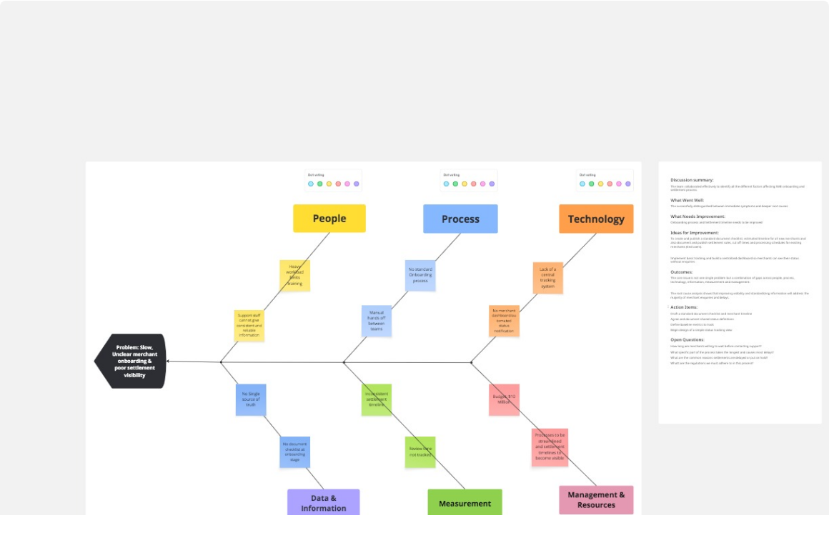
ROOT CAUSE DIAGNOSTIC
Fishbone Diagram Analysis (Ishikawa Model)
6 Contributing Branches • Miro Artifact

Slide 5
STRATEGIC EVALUATION
Gap Analysis & Target State Roadmap
1. Application Intake
Current State (FROM)
Future State (TO) & Remedy
Process Gap
Applications submitted via forms, emails, and chat. Re-typed manually with zero checklists.
Single digital portal with upfront eligibility checklist and estimated review timeline displayed.
2. Status Tracking
Current State (FROM)
Future State (TO) & Remedy
Technology Gap
Merchants call/email repeatedly. Spreadsheets across teams hold conflicting status terms.
24/7 self-service dashboard with unified status glossary and support mirror console.
3. Settlement Visibility
Current State (FROM)
Future State (TO) & Remedy
Information Gap
Cut-off rules held internally; staff lack knowledge; merchants endure cash-flow panic.
Published schedule with cut-off dates, holiday rules, and compliance-approved estimates.

Slide 6
DISCOVERY & STRATEGY
Elicitation Insights & Phased Recommendation
STAKEHOLDER ELICITATION LOG
RECOMMENDED STRATEGY
HYBRID APPROACH
Merchants (End Users)
Combining Immediate Process Wins with Long-Term Tech
Demand upfront checklists and self-service date tracking to run payroll.
Phase 1: Process Alignment (Weeks 1–2)
Customer Support
Standard checklist, shared status board, and published settlement draft.
Require a mirrored portal view with internal notes to eliminate triage guesswork.
Phase 2: Self-Service Portal (Months 1–3)
Compliance vs. Finance
Merchant dashboard, status tracking bar, automated email/SMS alerts.
Agreed on Controlled Disclosure: public general timelines, protected audit logs.
Phase 3: Automated Settlements (Months 3–6)
Read-only Finance APIs and automatic date calculations.

Slide 7
REQUIREMENTS ARCHITECTURE
BRD & FRD Functional Scope (MoSCoW)
FR-001 • FR-003 • MUST
FR-004 • FR-005 • MUST
FR-007 • FR-008 • MUST
FR-006 • FR-009 • SHOULD
Unified Digital Intake
Merchant Dashboard
Public Schedule
Alerts & Mirroring
Online registration with upfront checklist, client-side validation, and draft-saving.
Real-time stage tracking bar, next steps, and estimated settlement date display.
Transparent cut-off times, holiday rollover rules, and compliance-approved templates.
Automated email/SMS milestone updates and internal support mirror console.

Slide 8

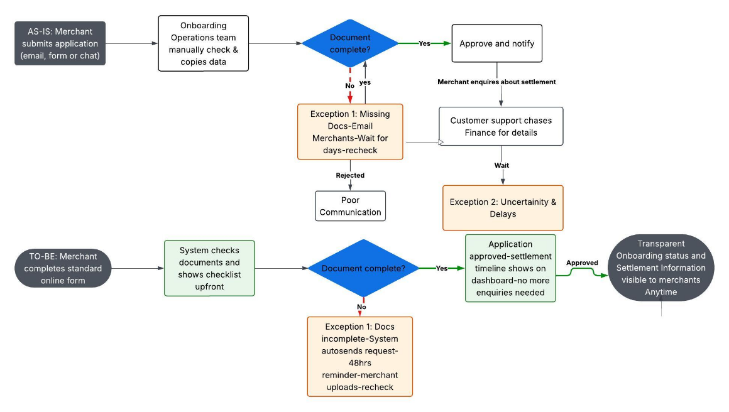
PROCESS ENGINEERING
AS-IS vs. TO-BE Operational Process Model
End-to-End Swimlane & Exceptions

Slide 9
GOVERNANCE & CONTROLS
Key Project Risks & Mitigation Strategy
Identified Risk | Impact | Agreed Mitigation Strategy | Owner
Merchant Adoption Gap |  | Email banner invites and a 2-week dual transition period. | Support Lead
Finance System Sync Delay |  | Deploy scheduled batch exports as interim fallback before live API sync. | IT & Finance
Compliance Rejection |  | Pre-approved public templates; 3-day turnaround SLA established. | Compliance Officer
Internal Terminology Conflict |  | Conduct cross-team status glossary workshop with signed sign-offs. | Business Analyst
Medium / High
Low / Medium
Medium / Medium
Low / Medium

Slide 10

EXECUTION ROADMAP
Moving from Governance to Execution
Immediate action plan to implement quick operational relief and initiate development.
STEP 01
STEP 02
STEP 03
BRD / FRD Sign-Off
Phase 1 Process Rollout
Figma & Sprint Planning
Secure formal approval from Compliance, Finance, and Head of SME Banking.
Distribute standard document checklists and activate internal shared tracking board.
Hand over FRD mockups to IT engineering to begin sprint development for portal.
Questions & Discussion

